Slide 1
Let’s talk TABOO.
How much money women spend in their lifetime on feminine products across Europe?

Slide 2
I gathered prices of pads and tampons from online stores in each country and averaged them.. With the lowest cost per unit being 0,10€ in Poland and the highest cost 0,20€ in Greece and Denmark.

Slide 3
How much does it cost to be a woman in Europe?
The average woman menstruates from age 13 until age 51, about once a month, with each period lasting from three to seven days. All in all, this equals 456 periods over a span of 38 years, which amounts to roughly 2,280 days of your life spent bleeding. One would typically use 3 to 5 pads or tampons a day.
“Lifetime period cost.”
2280days * 4 units a day = 9120 units in lifetime
9120* price per unit= lifetime period cost
Tampons and pads are necessities, yet still some countries tax them as luxuries.
I gather data on tax in each country and compared it with lifetime period cost in each Eu member state.

Slide 4
Lifetime period cost vs Period Tax

Slide 5
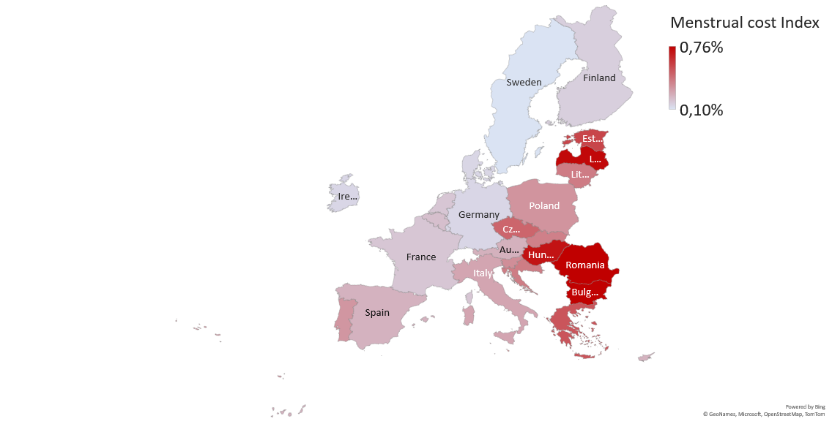
The Menstrual cost Index in the EU.
We see that in countries like Romania, Bulgaria, Latvia and Hungary with an average minimum salary of just 424 € females spend 0.74%-0,76% of their yearly minimum salary while in Sweden it would be only 0,10%.
Bigger the percentage spent on feminine products compared with minimum salary the darker the color.

Slide 6
Since the year 2018, 8 member countries in the EU have lowered their “period” tax but in 6 of these countries, this rate STILL is over 20%.

Slide 7
Tampon shortage and price increases.
According to Nielson IQ, tampon prices are at all-time highs because of inflation. Since last May 2021, average tampon prices have risen 9.8 percent.
Costs are soaring for components such as plastics, fluff pulp and cotton, leading to price hikes for pads and tampons
The increases are squeezing especially low-income consumers. Unlike with shampoo or razors, though, people with monthly periods can’t easily cut back on consumption or wait for prices to decline.
~Bloomberg By Daniela Sirtori-Cortina and Olivia Rockeman
June 9, 2022
According to a June 7, 2022 article in Time magazine, tampons have been in short supply for more than six months, and nobody has been talking about the great tampon shortage of 2022.

Slide 8
What are the alternatives in this sex-based discrimination?
Menstrual cups are made to last a minimum of five years or more. After use, you just need to wash them. In 5 years, you need one. (~18 €)
Period underwear. Most pairs can typically last between two and four years needs to be washed after one day of use. In 5 years, you need 4 pairs minimum which would total 88€ and that’s without washing cost.
Menstrual cups are most cost-effective period product available.

Slide 9
Summary.
51% of population in European Union consist of females.
Feminine products in Poland have the lowest cost per unit of 0,10€ and the highest cost per unit in Greece 0,20€.
Average lifetime period cost in the EU is 1352€. Ranging from Poland 923€ to Denmark 1819€.
Countries with the highest lifetime period cost were Austria 1694€ with tax at 10%, Greece 1778€ with tax at 10%, Denmark 1819€ with tax at 25%.
In countries with lowest minimum salaries females have the hardest time affording tampons and pads. Romania, Bulgaria, Latvia, Hungary has the highest Menstrual cost Index for low-income woman with average minimum salary of just 424 €, they have to spend 0.71%-0.76% of their salary to menstruate.
Since the year 2018, 8 EU member states lowered their “period” tax but in 6 of these countries, this rate STILL is over 20%.
Menstrual cups are most cost-effective period product available on average saving us around 90%.

